Slide 1

CSE 470: Software Engineering Importance
BRAC University

Slide 2



Software Engineering Roles
User – Who actually uses
Customer / Business People – Who initiates to build it for business
Development Company/ Team – Who develops it (Management, Programmers)

Slide 3
Software Myths
Management Myths
We already have a book that’s full of standards and procedures for building software. Won’t that provide my people with everything they need to know.
My people do have state-of-the-art software development tools
If we get behind schedule, we can add more programmers and catch up – Mongolian Horde Concept

Slide 4


Software Myths
Customer myths
A general statement of objectives is sufficient to begin writing programs…we can fill in the details later.
Project requirement continually change, but change can be easily accommodated because software is flexible.
Expectation Changed

Slide 5
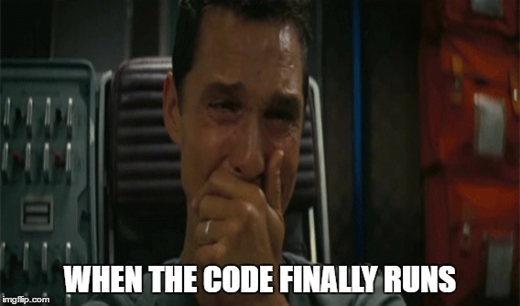
Software Myths
Programmer myths
Once we write the program and get it to run, our job is done.
A working program is a successful deliverable of the project.

Slide 6
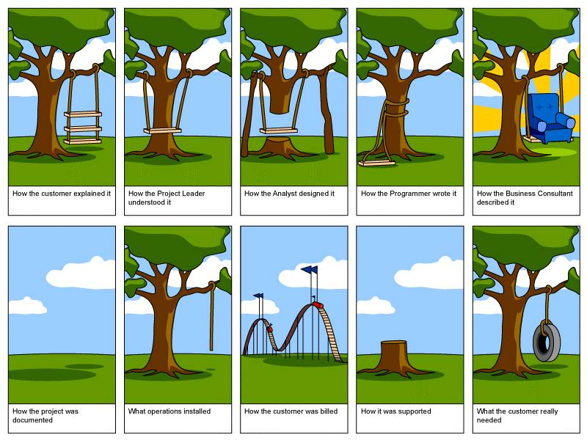
Expectation vs Reality
Reality
Expectation

Slide 7
Software Engineering Importance
Software is ever lasting and changing

Slide 8
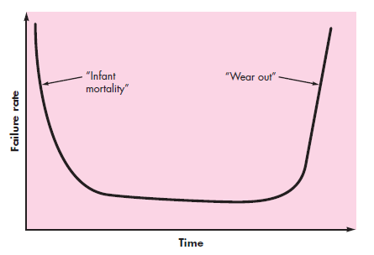


Software Engineering Importance
Hardware Failure Curve
Software is ever lasting and changing
Software Failure Curve

Slide 9

Software Engineering Importance
So, it is important because we need to develop a Good Software optimizing -
On time
On budget
With correct operation
With acceptable performance

Slide 10
What Is Good Software?
Lets say Facebook, what you want from it ?
It works properly
It loads faster
It loads easily anywhere mobile, tab, pc
We love new features
Our private chats
Even my little brother can use it ☺
As developers, we want easy API’s

Slide 11
What Is Good Software?
Lets say Facebook, what you want from it ?
It works properly [Correct]
It loads faster [Performance of Loading]
It loads easily anywhere mobile, tab, pc [Resource Usage]
We love new features [Easy Maintainable and Extendable]
Our private chats [ Security ]
Even my little brother can use it ☺ [User Interface]
As developers, we want to use their API’s[ Documentation]

Slide 12
Summary
Software engineering enables us to optimize time, budget, operation and performance for developing a good software .
A good software means the summation of various software attributes. And software engineering is the key to know and optimize the attributes.

